Slide 1
SPRINT – 1 (Loan Dataset)
Group-3
Devendra Kotiya
Jayant Kumar
Sumit Kumar
Anirban Dutta
Giridhar Kumar

Slide 2
INDEX
Step 1: Analyze the data set Loan.csv
Step 2: Load the data set into S3 bucket
Step 3: Creating a new S3 Event Notification to Automate Snowpipe
Step 4: Load the data from external stage to the respective table
Step 5: Please perform the below analysis on your dataset
Step 6: Github link of the codes

Slide 3
STEP 1: ANALYZE THE DATA SET Loan.csv
As the data set Loan.csv is in proper csv format

Slide 4
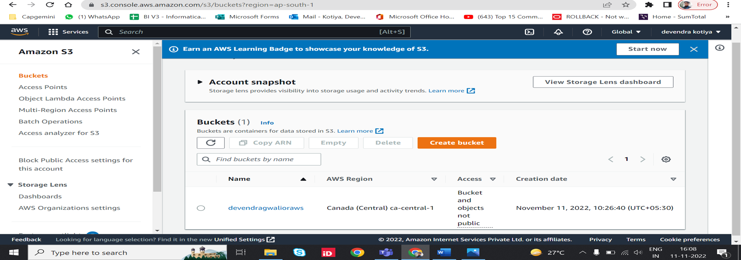
STEP 2: LOAD THE DATA INTO S3 BUCKET
Created a bucket in AWS S3.

Slide 5
Step 2.1: Configure Access Permissions for the S3 Bucket
2.1.1 AWS Access Control Requirements
Snowflake requires the following permissions on an S3 bucket and folder to be able to access files in the folder (and sub-folders):
s3:GetBucketLocation
s3:GetObject
s3:GetObjectVersion
s3:ListBucket

Slide 6
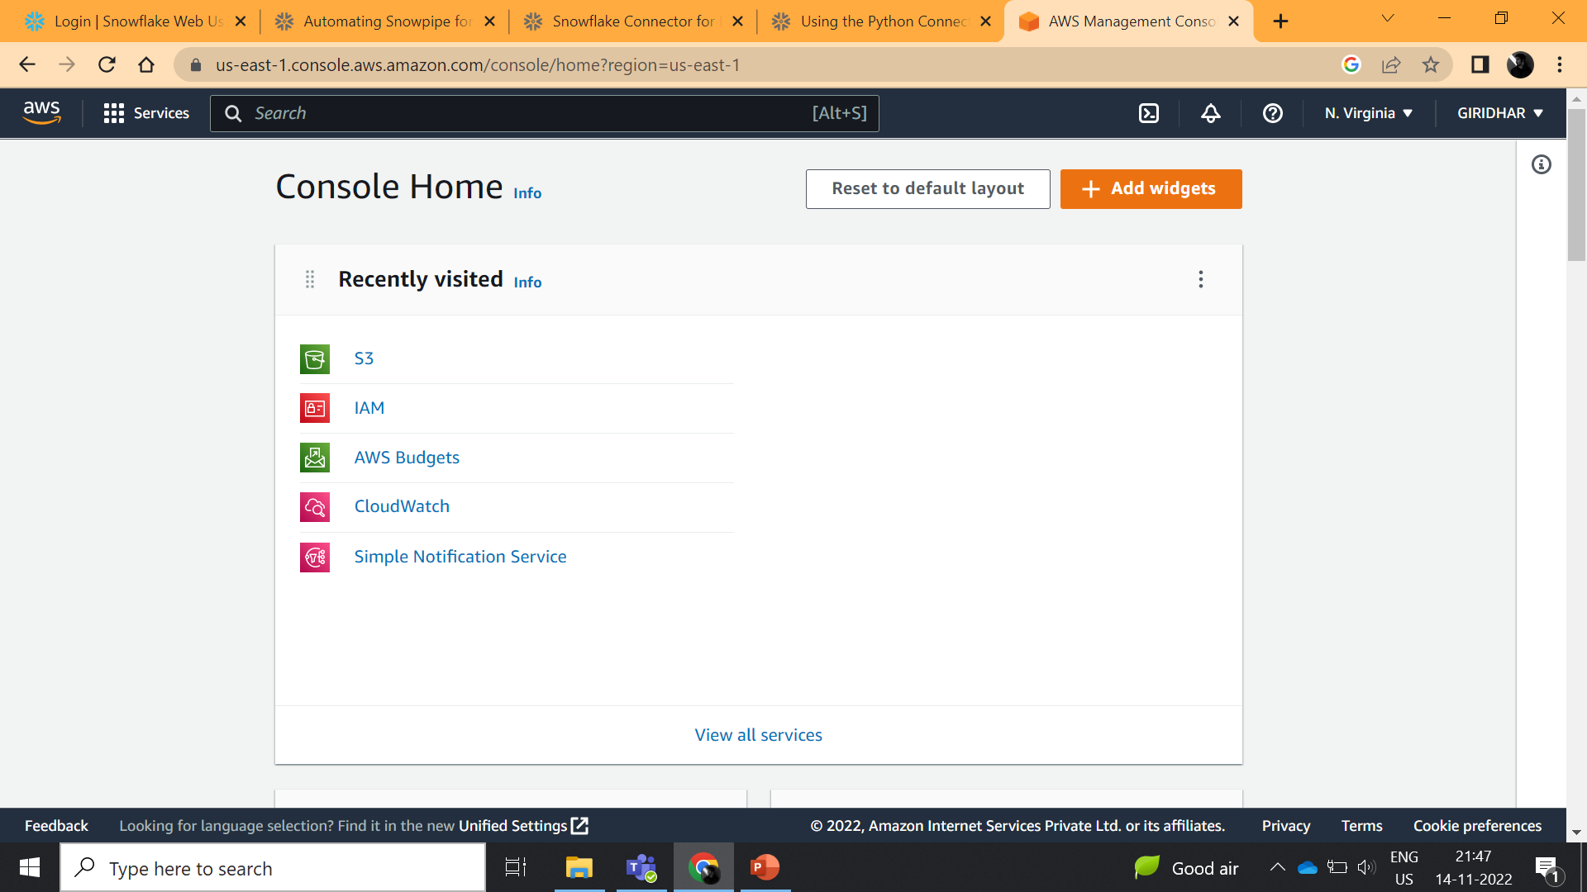
2.1.2 Creating an IAM Policy.
We created a IAM Policy for the Snowflake to access to the S3 bucket
Log into the AWS Management Console.
(ii) From the home dashboard, choose Identity & Access Management (IAM):

Slide 7
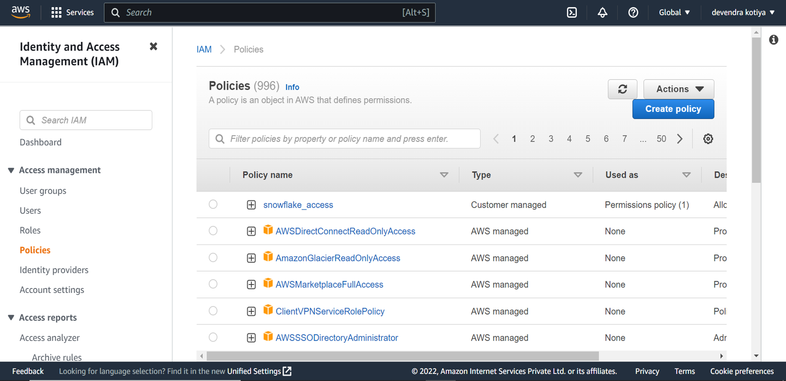
(iii) From the left-hand navigation panel expand the Access management.
(iv) Choose Policies.
(v) Click Create Policy:

Slide 8
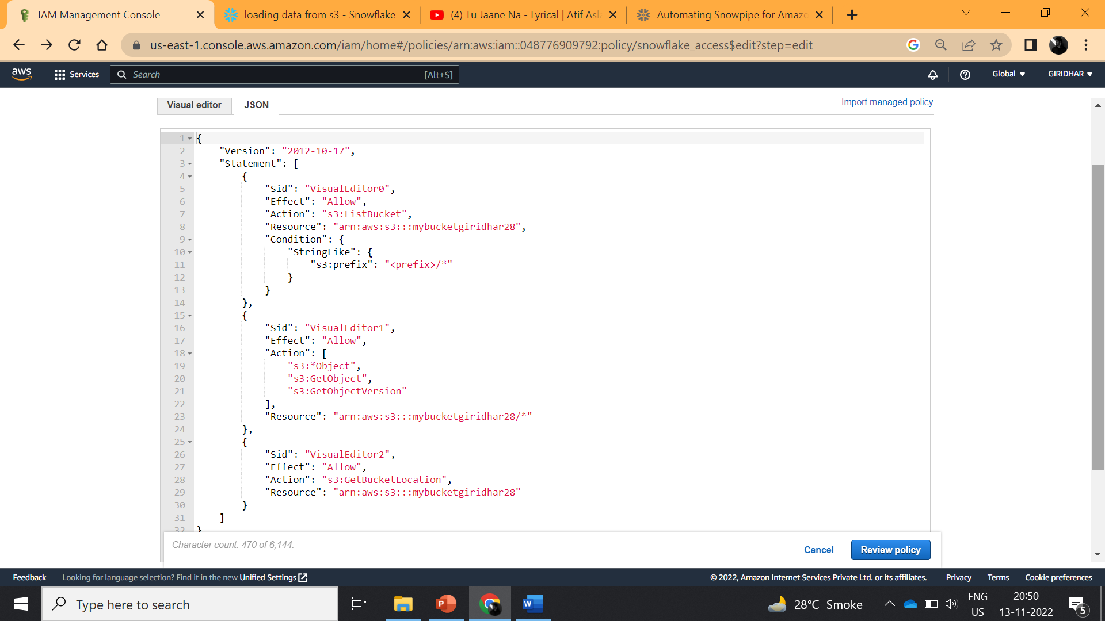
(vi) Click the JSON tab.
(vii) Add a policy document that will allow Snowflake to access the S3 bucket and folder
(viii) Click Review Policy.

Slide 9
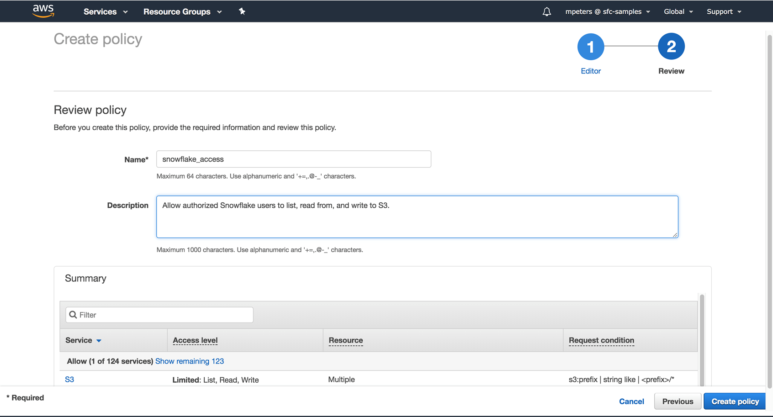
(x) Enter the policy name. Click create policy .

Slide 10
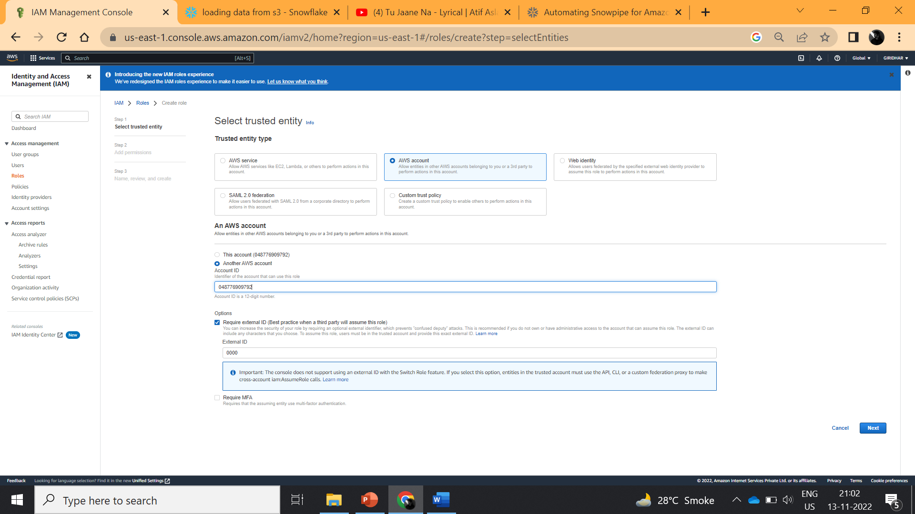
Step 2.2 Creating an IAM Role in AWS
We created an AWS IAM role to grant privileges on the S3 bucket.
(i) From the home dashboard, choose IAM
(ii) Choose Roles from the left-hand navigation pane. Click the Create role button.
(iii) Select Another AWS account as the trusted entity type.

Slide 11
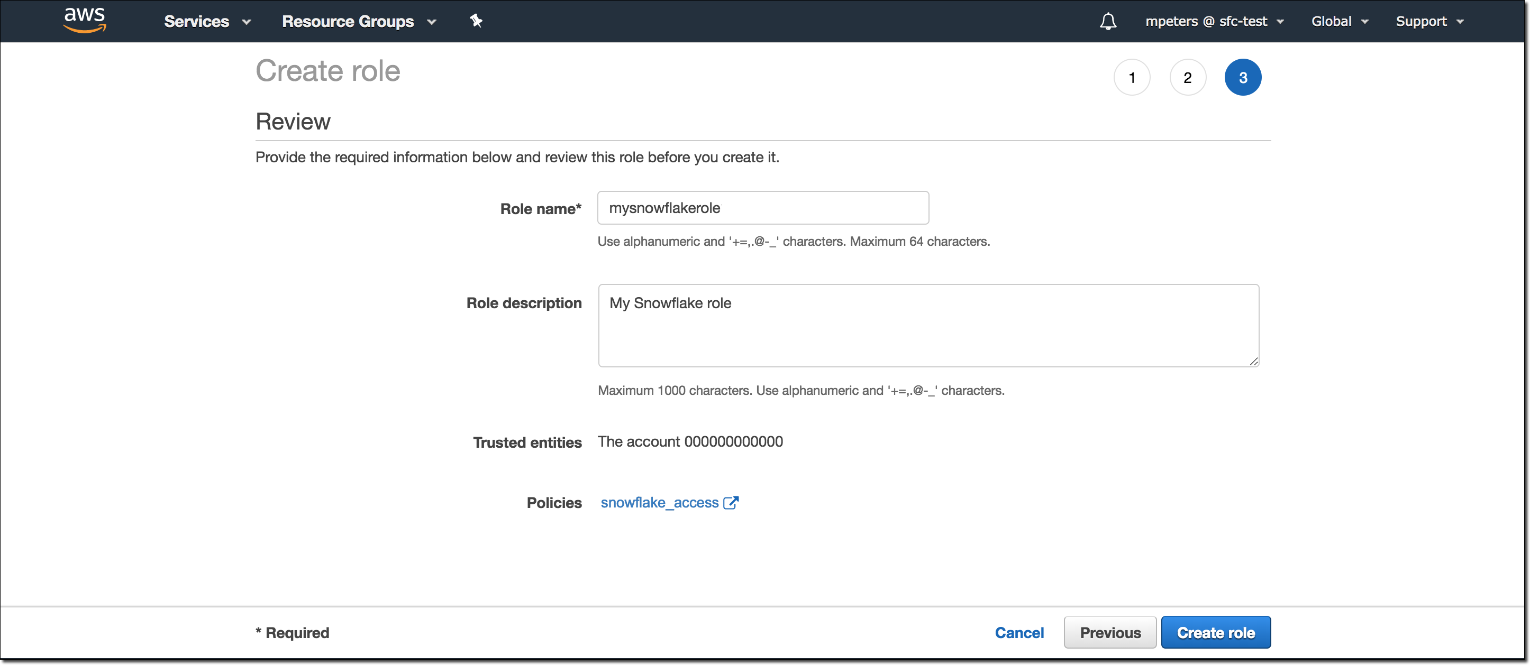
(iv) Entered a dummy credentials temporarily. Later we will modify this with the credentials from Snowflake.
(v) Click the Next button.
(vi) Locate the policy you created in Step 2.1.2 and select this policy.
(vii) Click the Next button.
(viii) Enter a name and description for the role, and click the Create role button.

Slide 12
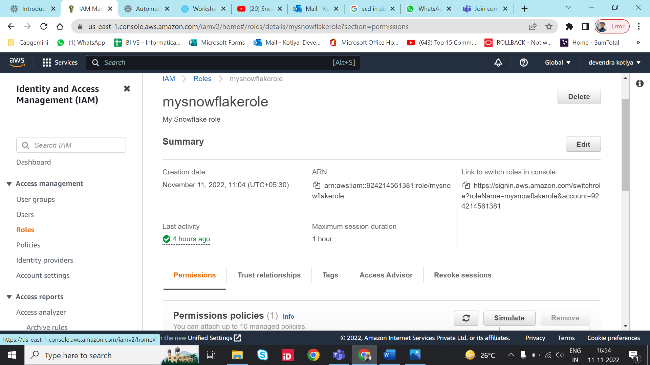
(ix) Now an IAM policy is created for a bucket, created an IAM role, and attached the policy to the role.
(x) We record the Role ARN value located on the role summary page.

Slide 13
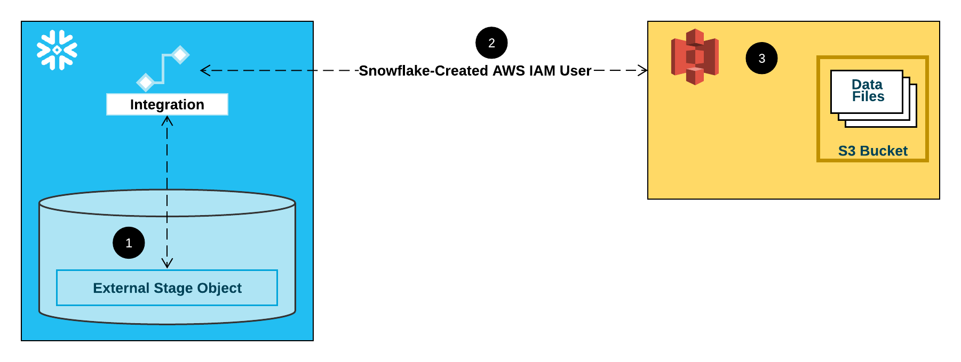
2.3: Create a Cloud Storage Integration in Snowflake
Integrations are named, first-class Snowflake objects that avoid the need for passing explicit cloud provider credentials such as secret keys or access tokens. Integration objects store an AWS identity and access management (IAM) user ID
Integration flow for a S3 stage

Slide 14
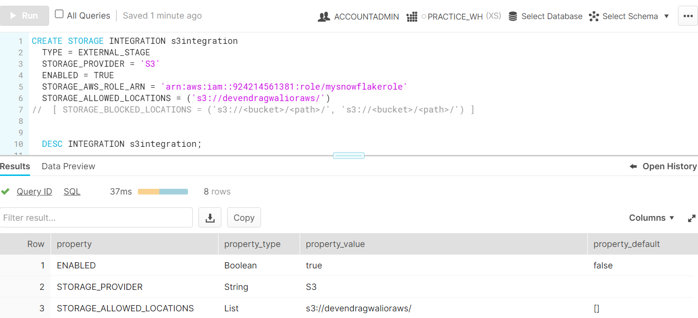
Created a storage integration using the CREATE STORAGE INTEGRATION command.

Slide 15
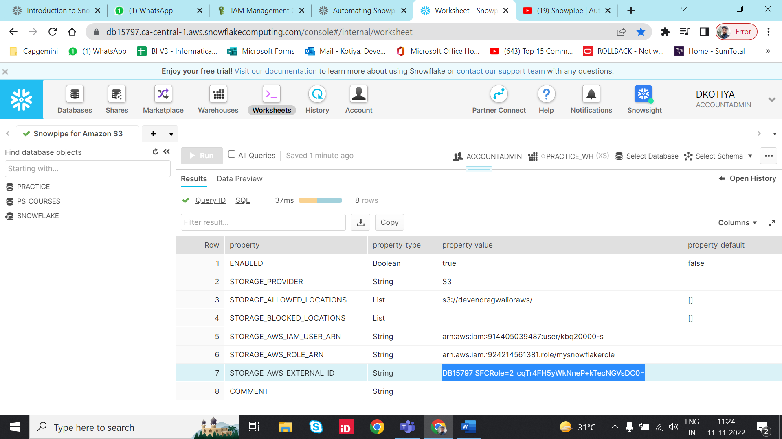
2.4: Retrieve the AWS IAM User for your Snowflake Account
Executed the DESCRIBE INTEGRATION command to retrieve the ARN for the AWS IAM user that was created automatically for our Snowflake account:

Slide 16
2.5: Configure Access Permissions for the S3 Bucket
Grant the IAM User Permissions to Access Bucket Objects
Configure IAM access permissions for Snowflake in AWS Management Console so that we can use a S3 bucket to load and unload data:
(i) Go to the home dashboard, choose IAM
(ii) Choose Roles.
(iii) Click on the role we created in Step 2.2
(iv) Click on the Trust relationships tab.
(v) Click the Edit trust relationship button.

Slide 17
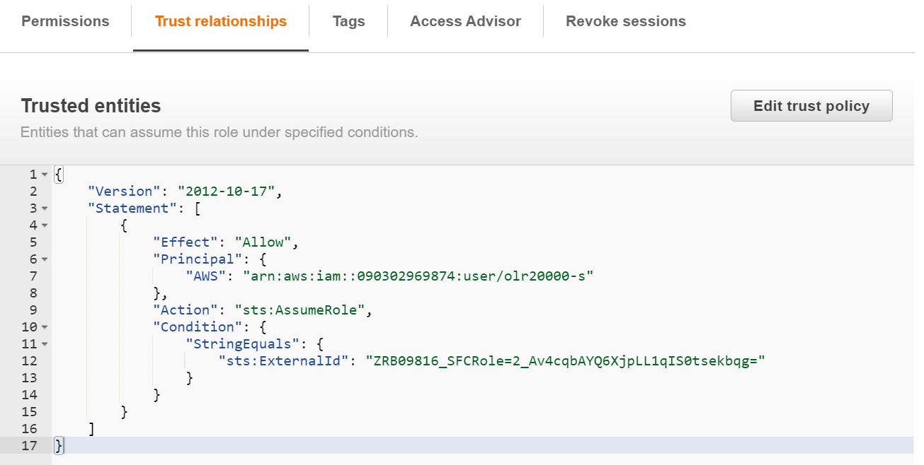
(vi) Modify the policy document with the DESC STORAGE INTEGRATION output values like user ARN and external ID we recorded in Step 2.4.
(vii) Click the Update Trust Policy button.

Slide 18
Step 3: Creating a New S3 Event Notification to Automate Snowpipe
Created an event notification for the path in S3 bucket.
The following diagram shows the Snowpipe auto-ingest process flow:

Slide 19
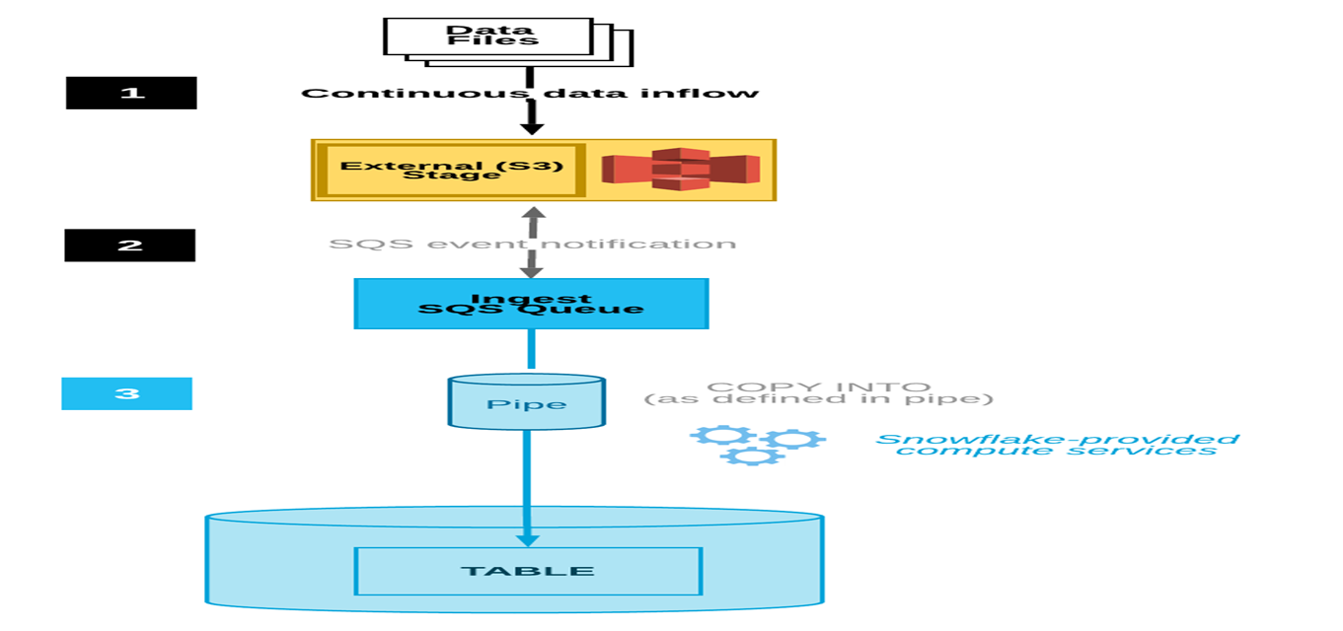
Snowpipe auto-ingest process flow

Slide 20
(i) Data files are loaded in a stage.
(ii) An S3 event notification informs Snowpipe via an SQS queue that files are ready to load. Snowpipe copies the files into a queue.
(iii) A Snowflake-provided virtual warehouse loads data from the queued files into the target table based on parameters defined in the specified pipe.

Slide 21
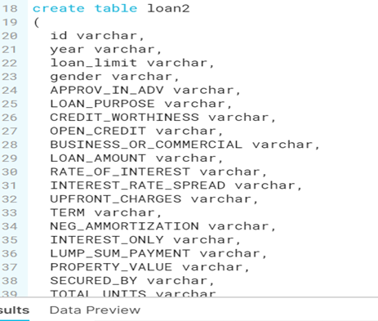
3.1 Creating a Table We created a target table (loan2) in the Snowflake database where our data will be loaded.

Slide 22
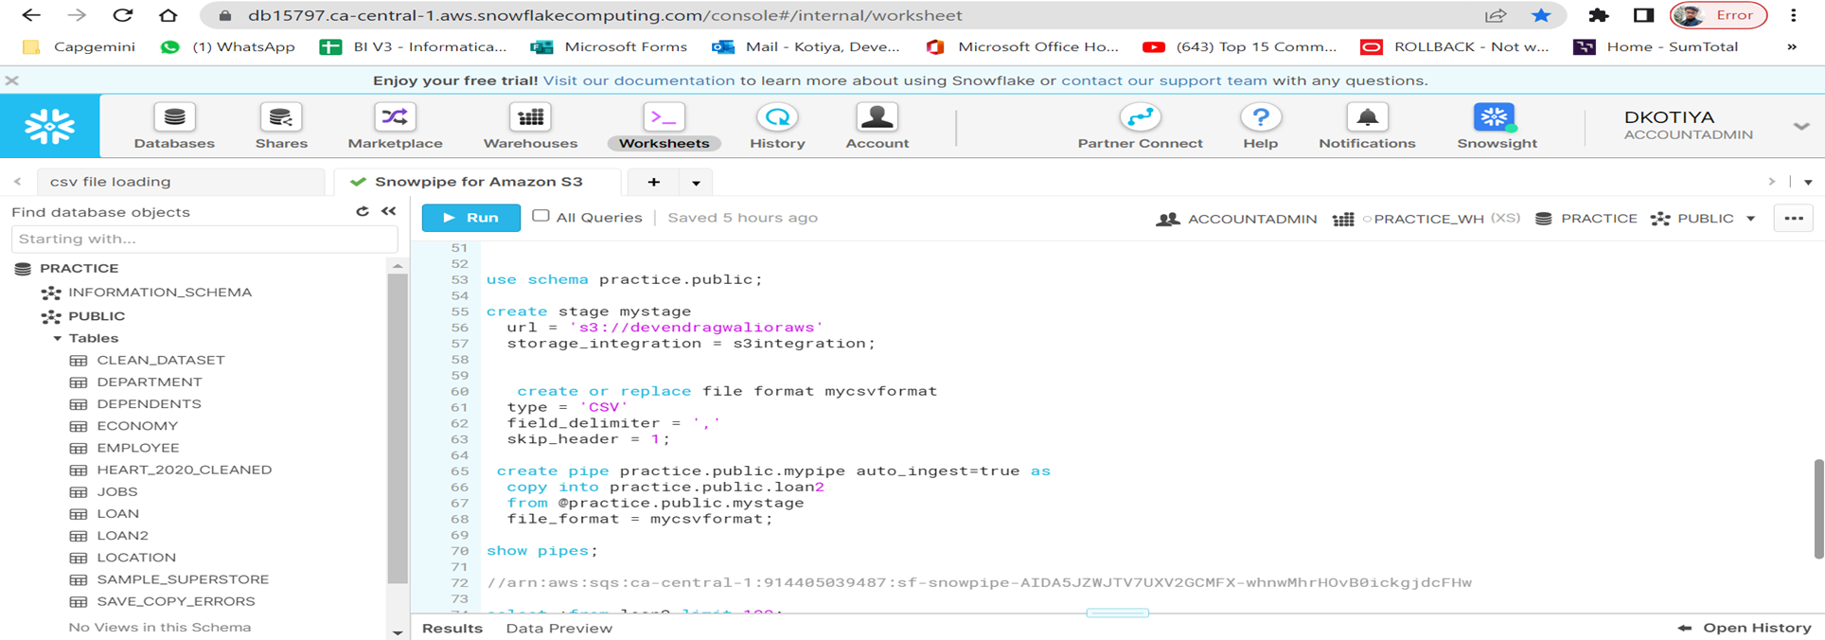
3.2 Create a File Format
Created a named file format with CSV as the file type

Slide 23
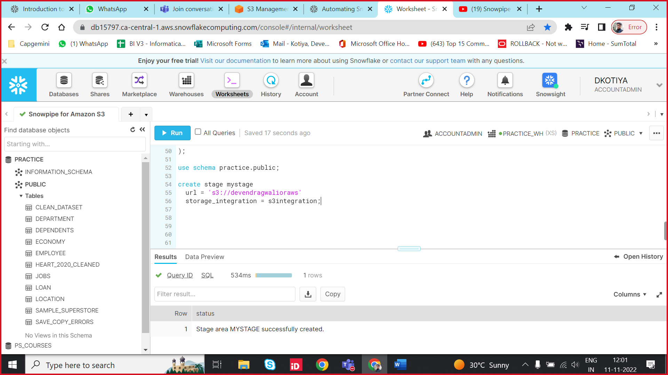
3.3 Create a Stage
Created an external stage that references our S3 bucket using the CREATE STAGE command. Snowpipe fetches our data files from the stage and temporarily queues them before loading them into our target table

Slide 24
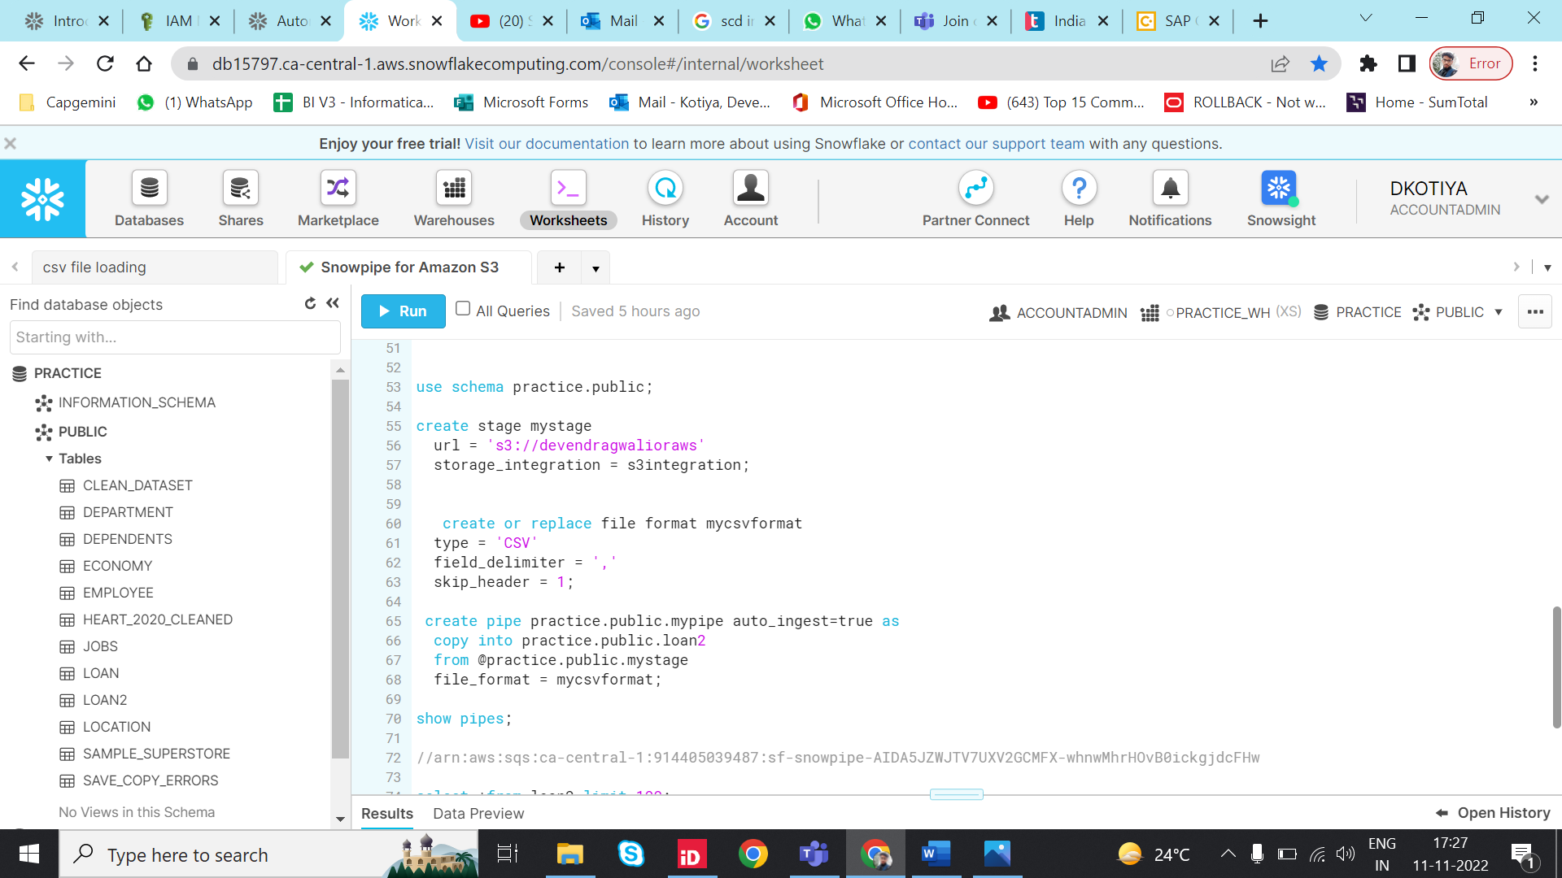
3.4 Creating a Pipe with Auto-Ingest Enabled
Created a pipe using the CREATE PIPE command. The pipe defines the COPY INTO <table> statement used by Snowpipe to load data from the ingestion queue into the target table.
* The AUTO_INGEST=true parameter specifies to read event notifications sent from an S3 bucket to an SQS queue when new data is ready to load.

Slide 25
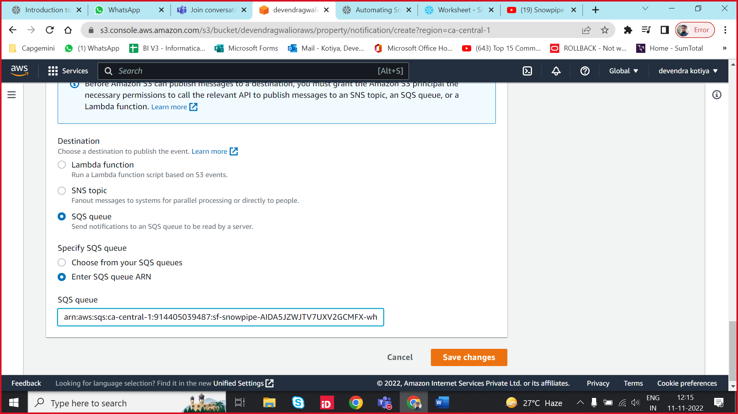
3.5 Configure Event Notifications
Configured the event notifications for our S3 bucket to notify Snowpipe when any new data is available to load. The auto-ingest feature relies on SQS queues to deliver event notifications from S3 to Snowpipe.
We run the SHOW PIPES command and copy the ARN of our SQS queue for the stage in the notification_channel column.
Move to the Amazon S3 console.
Configured an event notification for our S3 bucket

Slide 26
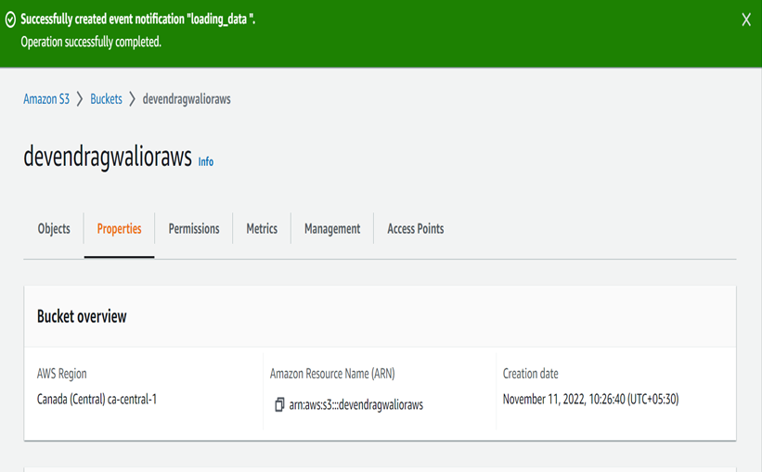

Slide 27
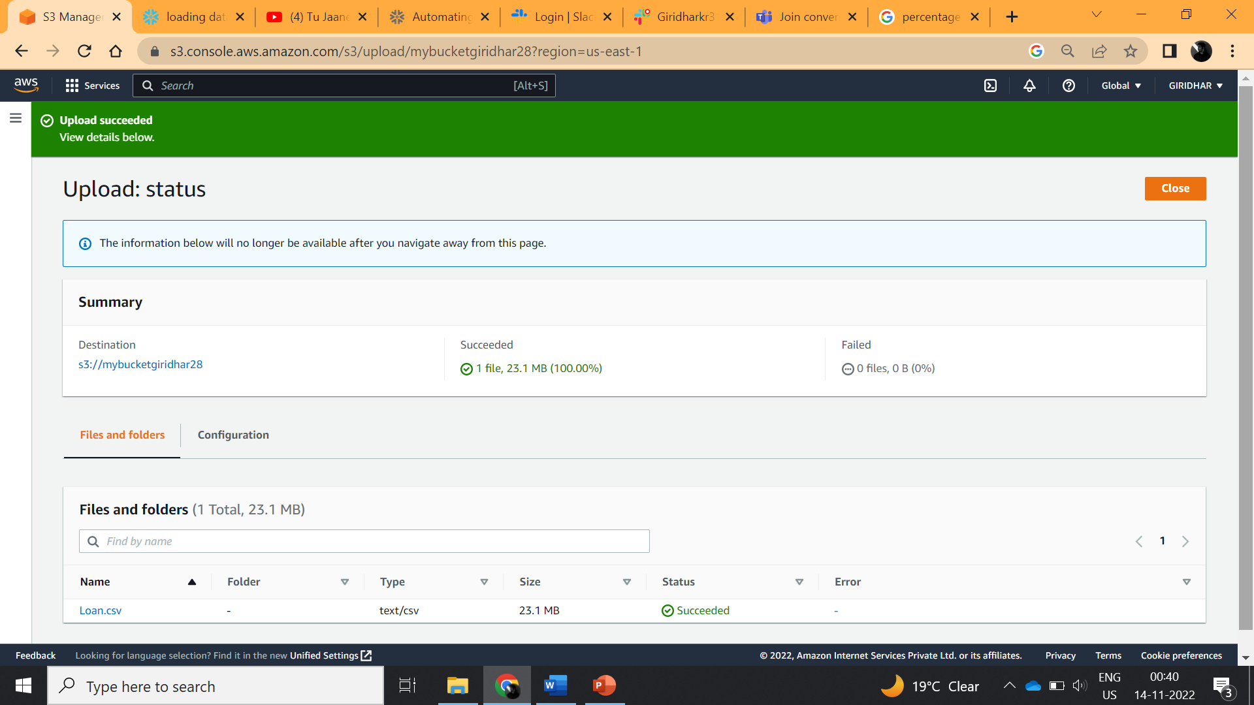

Slide 28
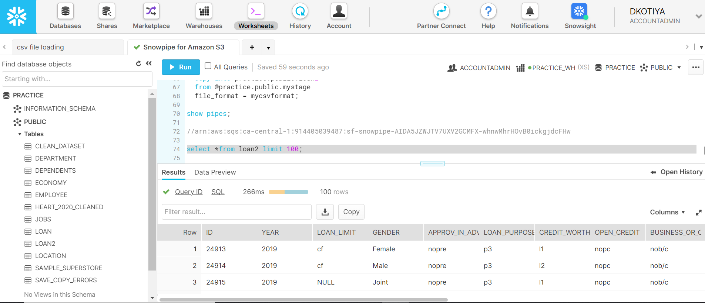
Step 4: Load the data from external stage to the respective table:

Slide 29
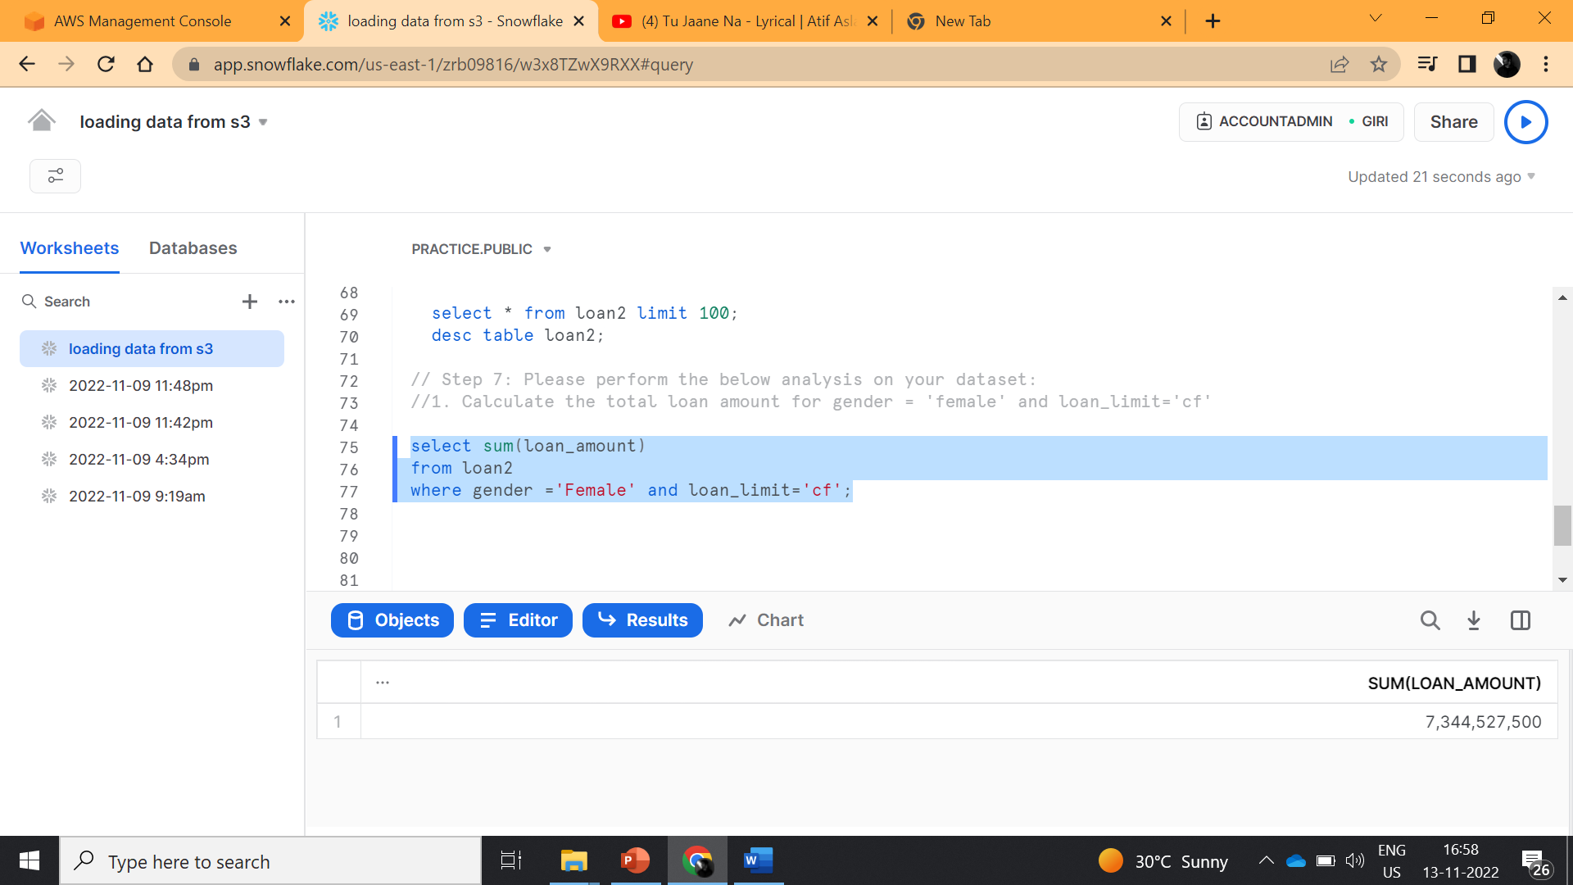
Step 5: Performed the below analysis on our dataset:
Q1. Calculate the total loan amount for gender = 'female' and loan_limit= 'cf'

Slide 30
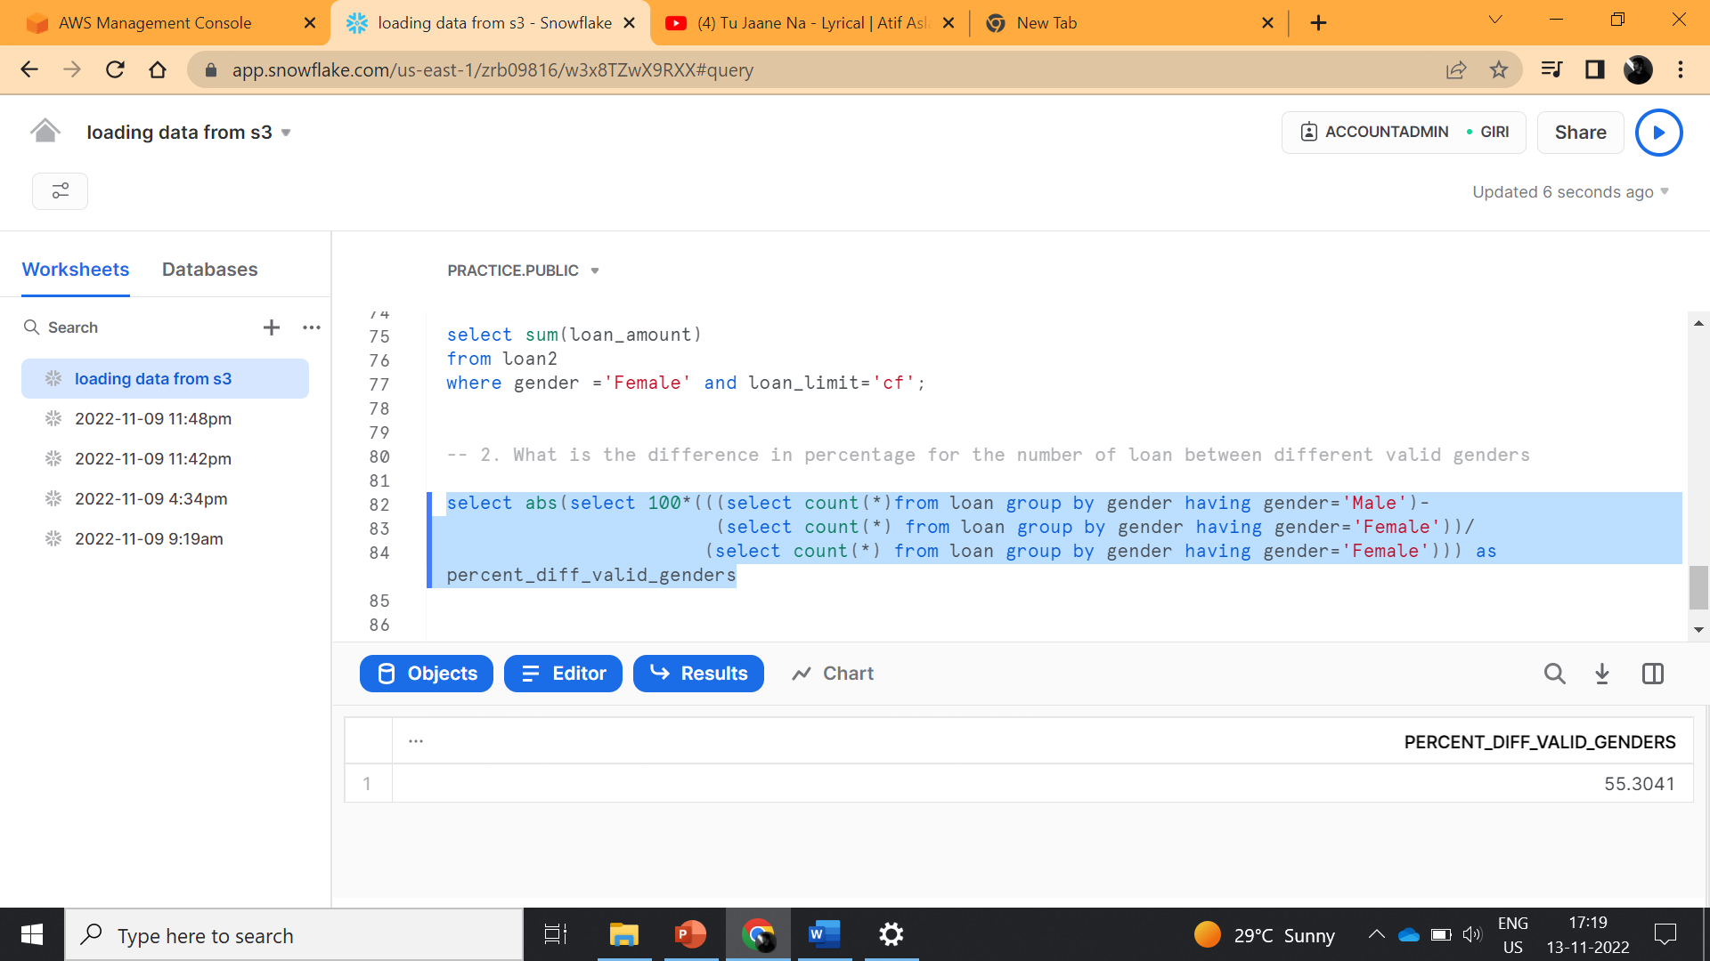
Q2. What is the difference in percentage for the number of loan between different valid genders

Slide 31
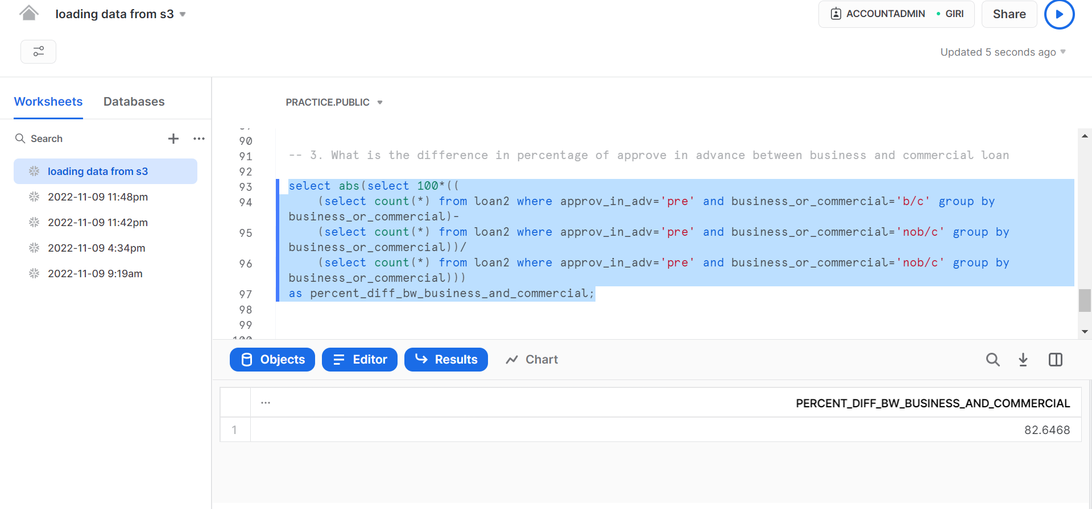
Q3. What is the difference in percentage of approve in advance between business and commercial loan

Slide 32
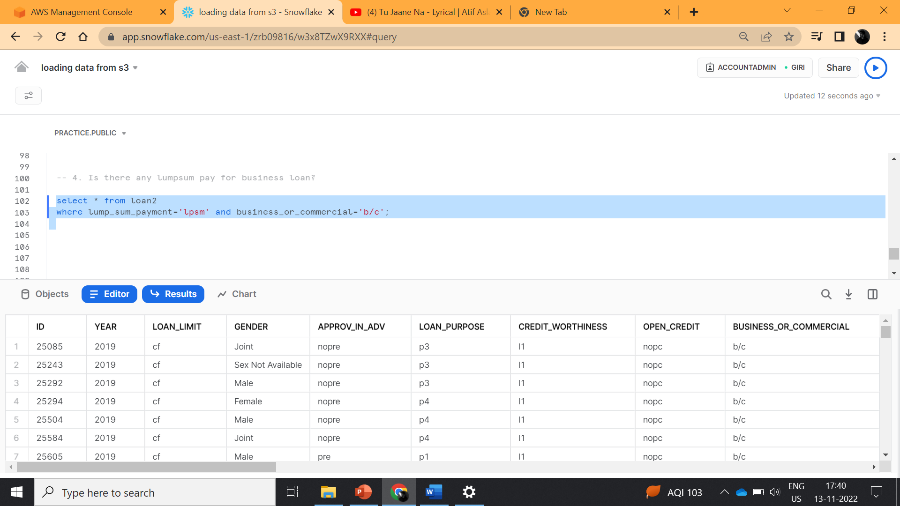
Q4. Is there any lumpsum pay for business loan?

Slide 33
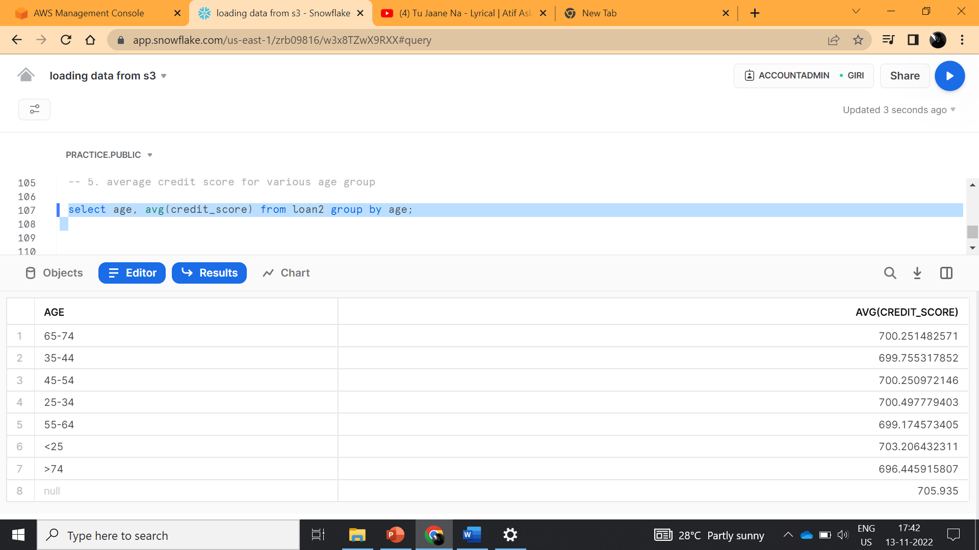
Q5. Average credit score for various age group

Slide 34
Step 6: Github link of the codes
https://github.com/kasiyadih/sprint1/tree/main

Slide 35
THANK YOU

